Slide 1
DANONE FRANCE
External Research

Slide 2
EXTERNAL RESEARCH
HISTORY & CULTURE OF FRANCE
HISTORY OF DANONE
ECONOMY
MARKET SIZE
CUSTOMER PROFILE
MARKETING OPPURTUNITIES
EVENTS AFFECTING FOOD PRODUCT CONSUMPTION

Slide 3
HISTORY & CULTURE OF FRANCE

Slide 4
History and culture
WIP
France was founded on September 22 of 1792 by Jerome Petion de Villeneuve.
It extends more than 543,940 square kilometers with around 67 million inhabitants.
France has been one of the major centers of finance, diplomacy, commerce, fashion, gastronomy, science, and arts of Europe.
Paris is often referred to as the “French Republic" and "L Hexagone" because the country is roughly six sided.
The official language of France is French.
Most popular sport- football.
The capital of Paris is France, and it also has the highest GDP per capita at $38,625.07.
The country boasts a 99 percent literacy rate.
French culture is most associated with Paris, which is a center of fashion, cuisine, art and architecture, but life outside the city of lights is very different and varies by region.
The most famous festivals are Bastille Day, Paris Carnival, Autumn festival, Jazz Festival.
Most consumed foods in Paris include Baguette, Croissants, Macarons, Cheese, Fish, Pizza, Ice cream, Hamburgers.
France spends around 11.2 percent of its GDP on healthcare, which is on the verge to increase since 2018.

Slide 5
DANONE HISTORY

Slide 6
The journey
WIP
1919
1929
1941
1972
1990
1996-2006
2015-2018
2020
Launched in Paris, France
Merged with BSN-Gervais,
Described company’s mission as “Bringing Health through Food”
Danone turns 100
Founded as “Dannon” by Isaac Carasso
Launched Dannon USA, New York
Expanded business in Asia and Latin America
WhiteWave Acquisition
Achieved B Corp Certification

Slide 7
ECONOMY

Slide 8
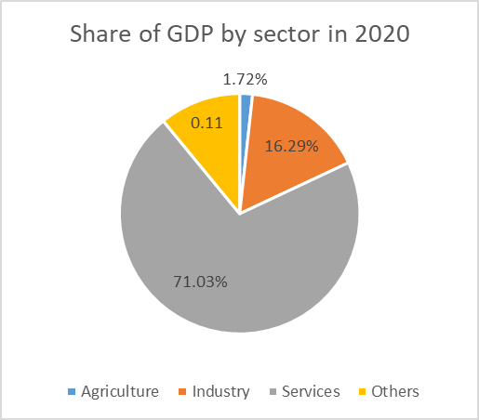
Economy of France
Population: 68,035,000 (January 2021)
Main Industries:
Machinery,
Metals,
Chemicals,
Automobiles,
Aircraft,
Textiles,
Cosmetic and Luxury Goods,
Electronics.
Food Processing,
Tourism And
Nuclear Energy
Major economic centres:
Paris
Lyon
Toulouse
Marseille and
Lille
AGRICULTURE IN FRANCE
6th largest agricultural producer
2nd largest agricultural exporter (after US)
EU's leading agricultural power
1/3rd of agricultural land in EU
France was the world's 20th country by GDP per capita with $39,257 per inhabitant.​

Slide 9
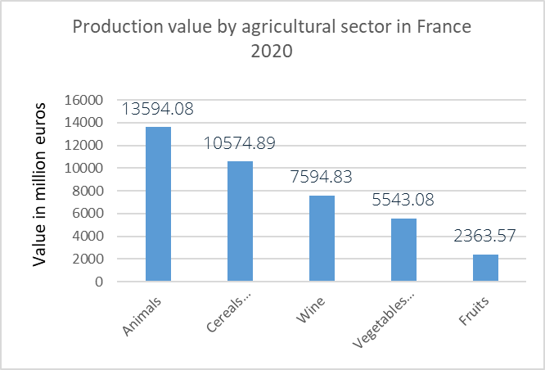
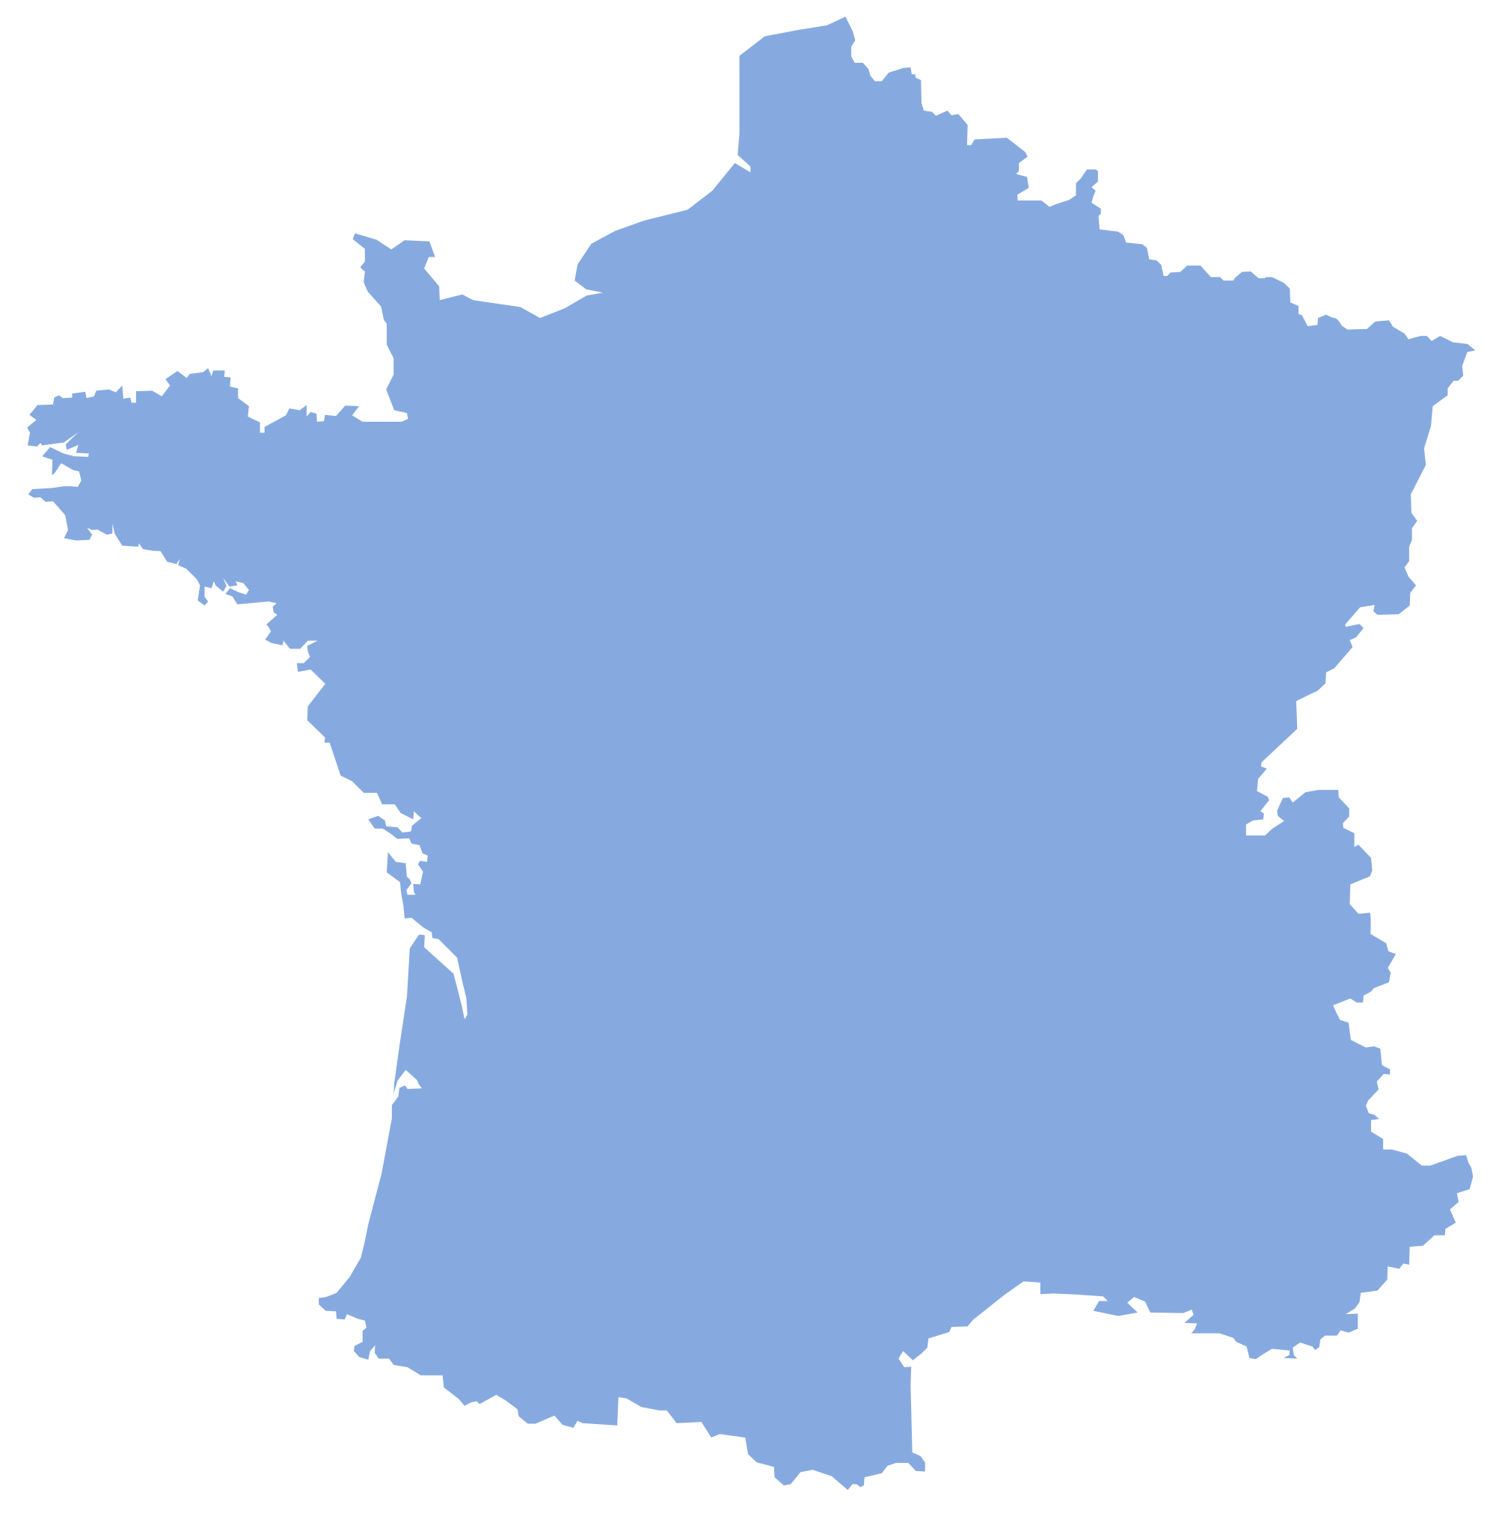

Agriculture sector of France
Production of agricultural products characterized by region
Large wheat farms
Dairy products,
pork, poultry,
and apple
Beef production
Fruits, vegetables, and wine
Fruits, vegetables, and wine
Leading producer of the three principal grains- wheat, barley, and maize

Slide 10
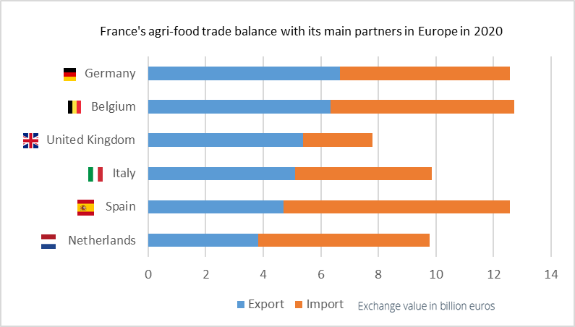
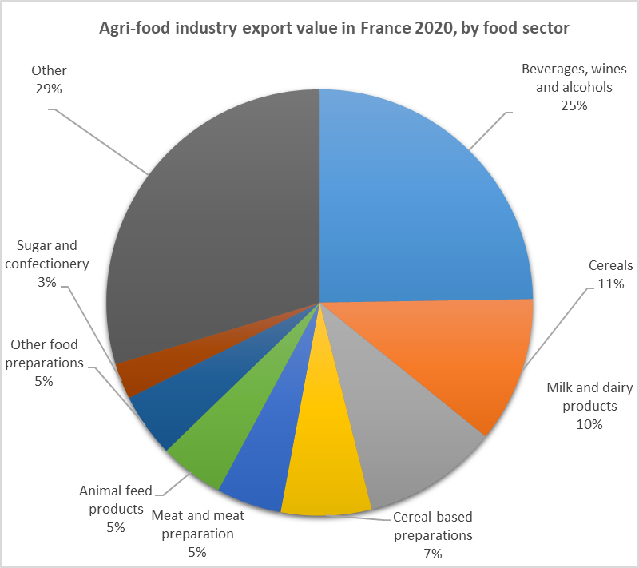
Agri-food trade of France
Global leader
for wine exports
Europe’s #2 producer of organic milk
world’s #1 exporter of jam, marmalade, jelly, purée and fruit jellies
France is the world’s leading exporter of fresh potatoes
Europe’s #1 beef
(and meat) producer

Slide 11
Market size

Slide 12
France contributes 9% 0f total revenue
WIP

Slide 13
PRODUCT PORTFOLIO OF DANONE
WIP
ESSENTIAL DAIRY & PLANT BASED.
WATER.
SPECIALIZED NUTRITION.W

Slide 14
EDPB
WIP
14
Proprietary and Confidential

Slide 15
WIP

Slide 16
WATER
WIP
16
Proprietary and Confidential

Slide 17
WIP

Slide 18
WIP

Slide 19
SPECIALIZED NUTRITION
WIP

Slide 20
WIP

Slide 21
INFANT NUTRITION
WIP

Slide 22
WIP

Slide 23
CUSTOMER PROFILE

Slide 24
Understanding French Customers
WIP
Most French people are buying products that were advertised on the Internet and Television.
Most French people started preferring products that are made in France.

Slide 25
EVENTS AFFECTING CONSUMPTION OF FOOD PRODUCTS

Slide 26
Events affecting Food Product Consumption
WIP
Study of consumer’s behavior is important in developing marketing strategy. Consumer behavior refers to the attitude that the consumer shows during the search, purchase, and consumption of a certain product.
The major factors which affect the decision of the consumers whether to accept or reject a food product in the market:
• Economical determinants such as cost, income, availability
• Social determinants such as culture, family, peers, and meal pattern
• Biological determinants such as hunger, appetite, and taste
• Physical determinants such as access, education, skills (cooking) and time
• Psychological determinants such as mood, stress, and guilt
• Attitudes, beliefs, and knowledge about food

Slide 27
Events affecting Food Product Consumption
WIP
Economic Determinants
Social Determinants
Biological Determinants

Slide 28
Events affecting Food Product Consumption
WIP
Physical Determinants
Psychological Determinants
Attitudes, beliefs, knowledge

Slide 29
Events affecting Food Product Consumption
WIP
The complexity of food choices is obvious from the list above, which is not exhaustive.
Food choice factors also very according to life stage and power of one factor will vary from one individual or group of people to the next.
Thus, one type if intervention to modify food choice behavior will not suit all population groups.
Rather, interventions need to be geared towards different groups of the population with consideration to the many factors influencing their decisions on food choice.
Consumers have become more dependent on their own preferences by observing sensual attributes of the foodstuffs.

Slide 30
Thank you

